Slide 1
Final Presentation
Instructor: Professor Jack Bergersen
Term: Summer 2025
Date: 08/12/2025
Group 2:
Ruman Liu
Junhui Hu

Slide 2
CONTENTS
1
Introduction
Analysis
2
3
Conclusion

Slide 3
PART
01
Introduction

Slide 4
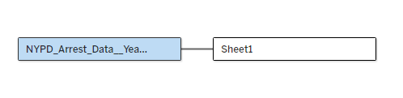
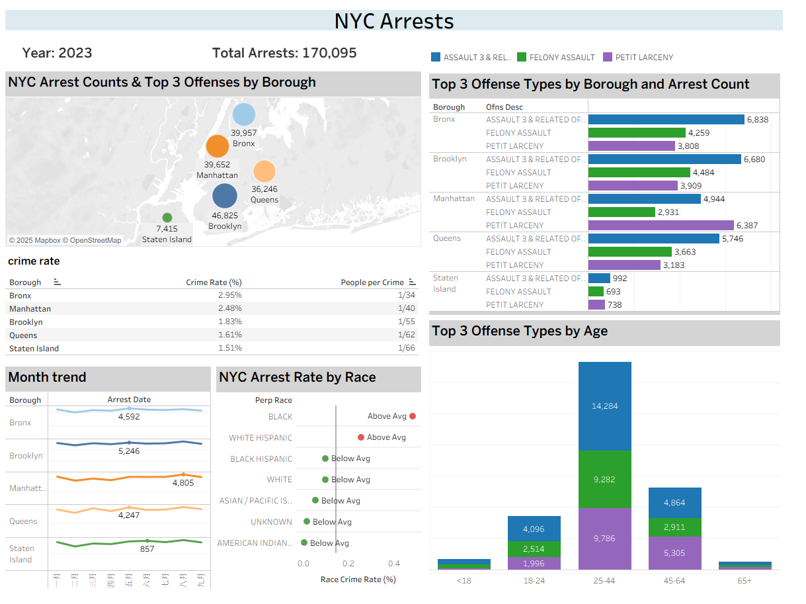
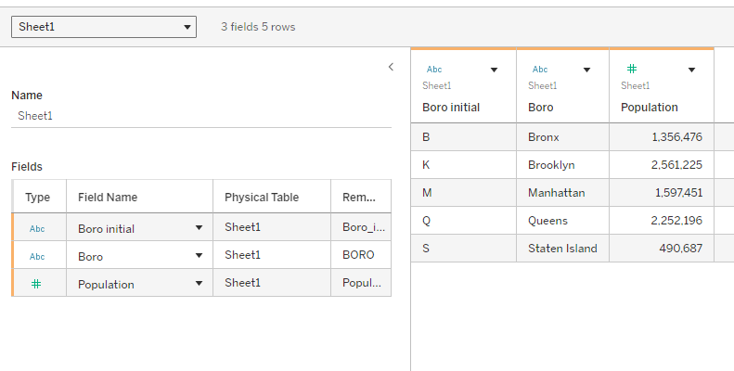
*POPULATION FOR NEW YORK CITY AND BOROUGHS AS OF JULY 1, 2023.

Slide 5
PART
02
Analysis

Slide 6
Research Question 1
Which borough in New York City has the highest number of arrests, and what are the most common offense types in those areas?
Purpose
Identify NYC crime hotspots and top offense types to improve police deployment and safety strategies.
01
Method
Data: NYPD Arrest Data (2023)
Key variables: ARREST_BORO (borough), OFNS_DESC (offense type)
Tools: Tableau dashboard combining
Bubble map – arrest count (size), borough (color)
Stacked bar chart – top 3 offenses per borough
02

Slide 7
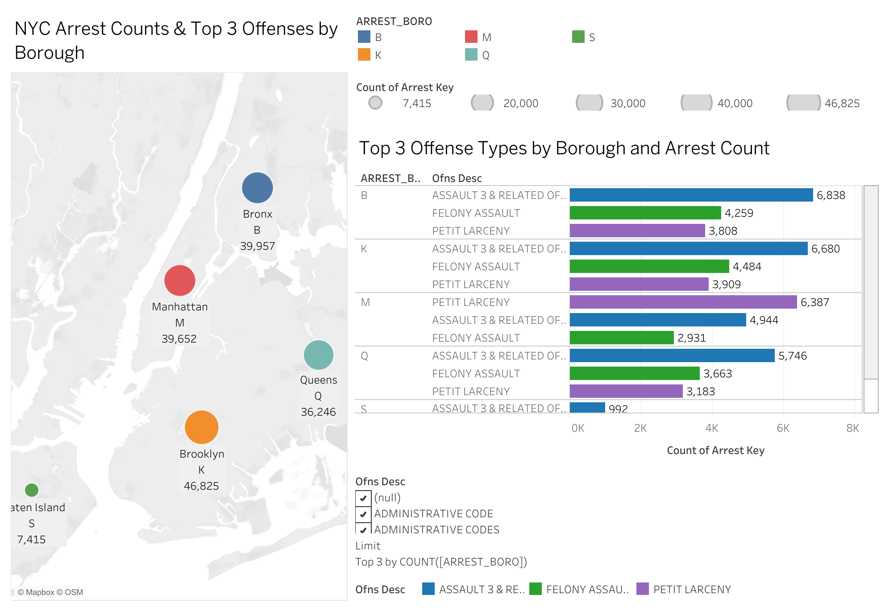
Dashboard
Findings
Brooklyn (46,825 arrests) had the highest arrest count, followed by Bronx (39,957) and Manhattan (39,652)
Across most boroughs, top 3 offenses: Assault 3 & Related, Felony Assault, Petit Larceny
Violent crimes more concentrated in Brooklyn and Bronx
Figure 1 :Dashboard showing NYC arrest counts and top 3 offense types by borough (2023).
Note. Bubble size represents total arrest count; colors represent borough. Data source: NYPD Arrest Data (2023).

Slide 8
Dashboard
Interpretation
Brooklyn is the main crime hotspot in NYC
High prevalence of violent and property crimes suggests the need for:
Increased police patrol presence
Expanded violence prevention programs
Theft deterrence measures
Figure 1 :Dashboard showing NYC arrest counts and top 3 offense types by borough (2023).
Note. Bubble size represents total arrest count; colors represent borough. Data source: NYPD Arrest Data (2023).

Slide 9
Research Question 2
What are the top 5 offense types for different age groups in NYC arrests (2023)?
Purpose
Analyze top 5 offense types by age group in NYC arrests (2023) to guide age-specific crime prevention strategies.
01
Method
Data: NYPD Arrest Data (2023)
Key variables: AGE_GROUP, OFNS_DESC
Tool: Tableau stacked bar chart showing arrest counts by age group, color-coded by top 5 offenses
02

Slide 10
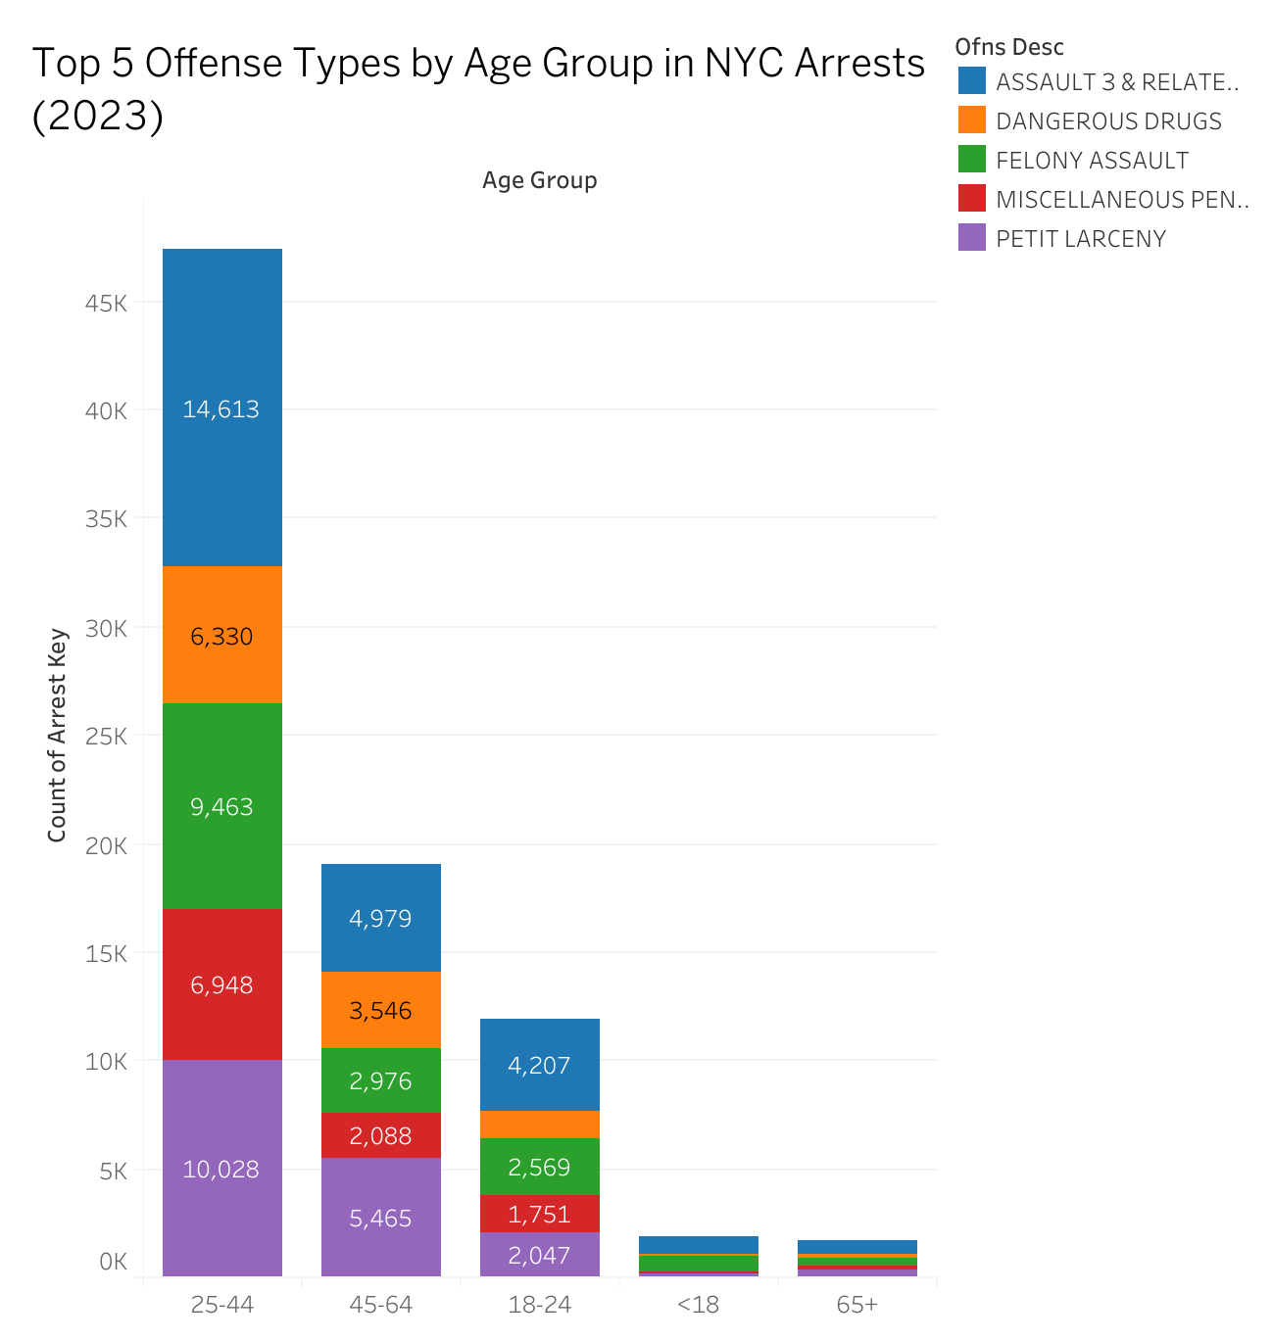
Findings
25–44: highest arrests; Petit Larceny (10,028) & Assault 3 (14,613) most common
45–64: fewer arrests, similar pattern
18–24: higher share of Assault 3 & Dangerous Drugs
<18: Robbery disproportionately high
65+: very low arrests, mostly Petit Larceny
Figure 2：Top 5 offense types by age group in NYC arrests (2023).Note. Colors represent offense types; bar height represents arrest counts. Data source: NYPD Arrest Data (2023).

Slide 11
Interpretation
Interpretation
Mid-adults (25–44) drive most arrests, mainly theft & assault
Youth programs should target robbery & violent behavior
Older adult prevention should focus on theft reduction
Figure 2：Top 5 offense types by age group in NYC arrests (2023).Note. Colors represent offense types; bar height represents arrest counts. Data source: NYPD Arrest Data (2023).

Slide 12
Research Question 3
How do crime rates differ across NYC boroughs?
Purpose
Shows crime rate and “people per crime” for each borough.
01
Method
Data: NYPD Arrest Data (2023), NYC population (2023)
Key variables: Arrest Key, Population
Tool: matrix shows borough, crime rate and people per crime
02
Notes:
Crime Rate (%) = COUNT([Arrest Key]) / AVG([Population])
People per Crime = ROUND(AVG([Population]) / COUNT([Arrest Key]), 0)

Slide 13
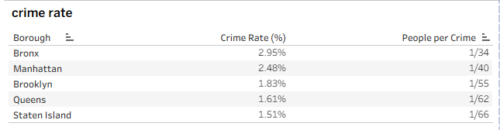
Findings
Bronx has the highest crime rate (2.95%, 1 crime per 34 people).
Staten Island has the lowest (1.51%, 1 crime per 66 people).
Manhattan’s rate is higher than Brooklyn even it has lower total arrests.
Notes:
Count(Arrest case) / total population = crime rate

Slide 14
Research Question 4
How do monthly arrest trends vary across NYC boroughs?
Purpose
Shows monthly arrest trend for each borough.
01
Method
Data: NYPD Arrest Data (2023)
Key variables: Borough, Arrest Date, Arrest Key
Tool: Line chart represent every borough with individual axis
02
Notes:
Crime Rate (%) = COUNT([Arrest Key]) / AVG([Population])
People per Crime = ROUND(AVG([Population]) / COUNT([Arrest Key]), 0)

Slide 15
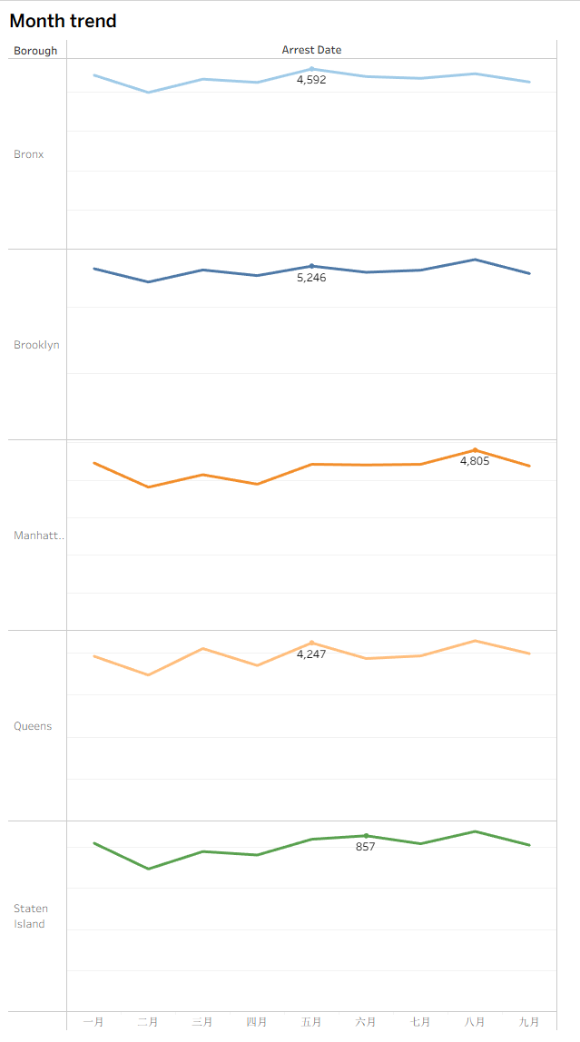
Findings
Seasonal fluctuations are small; overall trends are stable.
Brooklyn and Bronx consistently have high arrest numbers; Staten Island remains low.

Slide 16
Research Question 5
What is the arrest rate for each race in NYC, and which are above or below the citywide average?
Purpose
Shows crime rate by race with an average reference line.
01
Method
Data: NYPD Arrest Data (2023)
Key variables: Race Crime Rate (%), Arrest Key
Tool: Circle marks, average reference line, color-coded by Zone Label
02
Notes:
Crime Rate (%) = COUNT([Arrest Key]) / AVG([Population])
People per Crime = ROUND(AVG([Population]) / COUNT([Arrest Key]), 0)

Slide 17
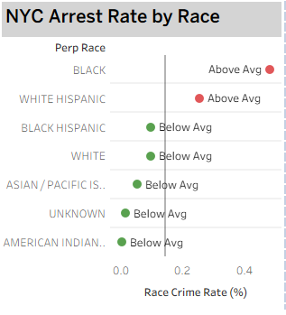
Findings
Black and White Hispanic are above average.
All other races are below average.
Notes:
Race Crime Rate (%) = COUNT([Arrest Key]) / TOTAL(COUNT([Arrest Key]))
Zone Label = IF [Race Crime Rate (%)] < WINDOW_AVG([Race Crime Rate (%)])
THEN "Below Avg" ELSE "Above Avg" END

Slide 18
Reference
POPULATION ESTIMATES FOR NEW YORK CITY AND BOROUGHS AS OF JULY 1, 2023.
https://www.nyc.gov/assets/planning/download/pdf/planning-level/nyc-population/population-estimates/current-population-estimates-2023-June2024-release.pdf?r=1&utm_source=chatgpt.com
Urban Audit city factsheets for 2019 Urban Adaptation Map Viewer, European Environment Agency, 2019. https://public.tableau.com/app/profile/european.environment.agency/viz/test_20190116Urban_vulnerability_ideasFR_0/mainpage

Slide 19
THANK YOU

